Slide 1





TEAM MEMBERS
1
Shubham Kumar Himanshu
PRN : 1262253979
Batch:1 , Div:2
4
Lukesh Bhosale
PRN : 1262253754
Batch:1 , Div:2
2
The Ride Plus
Aditya Dharme
PRN : 1262250178
Batch:1 , Div:2
5
Abhijeet Kadam Patil
PRN : 1262253319
Batch:1 , Div:2
Analyzing Delhi NCR's Transportation Ecosystem
Faculty Incharge:
Neha ma’am
3
Jaideep Kalekudithi
PRN : 1262253233
Batch:1 , Div:2

Slide 2

The Ride Plus
Introduction
TEAM MEMBERS
"The ride-hailing industry has transformed urban mobility, generating massive amounts of data that can provide valuable insights into customer behavior, operational efficiency, and business performance. This project focuses on analyzing ride-booking data from the National Capital Region (NCR) to extract meaningful patterns and business intelligence."
4
1
Lukesh Bhosale
PRN : 1262253754
Batch:1 , Div:2
Shubham Kumar Himanshu
PRN : 1262253979
Batch:1 , Div:2
Problem statement
2
5
Aditya Dharme
PRN : 1262250178
Batch:1 , Div:2
Abhijeet Kadam Patil
PRN : 1262253319
Batch:1 , Div:2
3
Faculty Incharge:
Neha ma’am
Jaideep Kalekudithi
PRN : 1262253233
Batch:1 , Div:2
To develop a comprehensive analytics dashboard that analyzes ride-booking patterns, identifies key performance indicators, uncovers cancellation reasons, optimizes revenue strategies, and provides actionable insights for improving service quality in the ride-hailing ecosystem.
Analyzing Delhi NCR's Transportation Ecosystem

Slide 3
4
Lukesh Bhosale
PRN : 1262253754
Batch:1 , Div:2
Algorithms
& Flowchart
Flowchart Used:
[Data Loading] → [Data Cleaning]
↓
[Exploratory Analysis] → [Statistical Analysis]
↓
📊 VISUALIZATION MODULES
↓
├── Booking Status Analysis
├── Temporal Pattern Analysis
├── Vehicle Performance
└── Cancellation Analysis
Algorithms Used:
Data Preprocessing Pipeline
Exploratory Data Analysis (EDA)
Statistical Analysis
Data Visualization Algorithms
Business Metrics Calculation
TEAM MEMBERS
1
Shubham Kumar Himanshu
PRN : 1262253979
Batch:1 , Div:2
Introduction
Dataset Source: Synthetic ride-booking data for NCR region.
Records: 1.5 Lakhs+ booking entries
Time Period: January 2024 - December 2024
"The ride-hailing industry has transformed urban mobility, generating massive amounts of data that can provide valuable insights into customer behavior, operational efficiency, and business performance. This project focuses on analyzing ride-booking data from the National Capital Region (NCR) to extract meaningful patterns and business intelligence."
2
Problem statement
Aditya Dharme
PRN : 1262250178
Batch:1 , Div:2
To develop a comprehensive analytics dashboard that analyzes ride-booking patterns, identifies key performance indicators, uncovers cancellation reasons, optimizes revenue strategies, and provides actionable insights for improving service quality in the ride-hailing ecosystem.
5
Abhijeet Kadam Patil
PRN : 1262253319
Batch:1 , Div:2
Key Features:
Temporal: Date, Time, Month
Financial: Booking Value, Ride Distance
Cancellation: Reasons for cancellations
Payment: Payment Methods
Datasheet
3
Dataset Source: Synthetic ride-booking data for NCR region.
Records: 1.5 Lakhs+ booking entries
Time Period: January 2024 - December 2024
Jaideep Kalekudithi
PRN : 1262253233
Batch:1 , Div:2
Faculty Incharge:
Neha ma’am

Slide 4
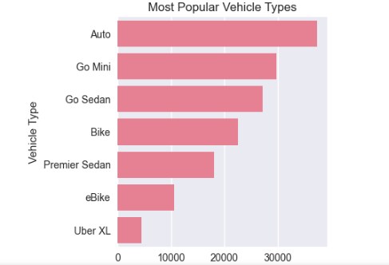
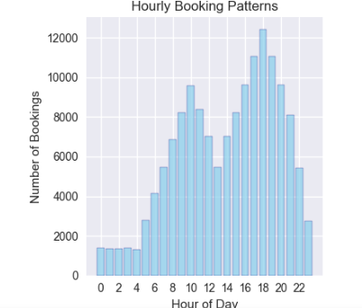
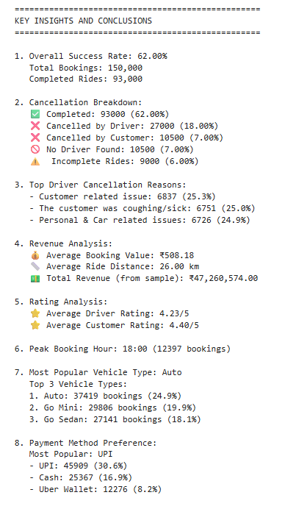
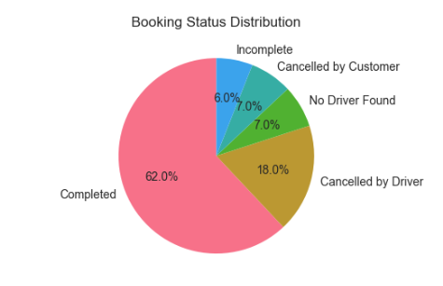
Some glimpse of the output
THANK YOU
Introduction
Algorithms
& Flowchart
Datasheet
"The ride-hailing industry has transformed urban mobility, generating massive amounts of data that can provide valuable insights into customer behavior, operational efficiency, and business performance. This project focuses on analyzing ride-booking data from the National Capital Region (NCR) to extract meaningful patterns and business intelligence."
Dataset Source: Synthetic ride-booking data for NCR region.
Records: 1.5 Lakhs+ booking entries
Time Period: January 2024 - December 2024
Algorithms Used:
Data Preprocessing Pipeline
Exploratory Data Analysis (EDA)
Statistical Analysis
Data Visualization Algorithms
Business Metrics Calculation
Problem statement
Conclusion
This project successfully demonstrates how data analytics can transform raw ride-booking data into actionable business intelligence. The analysis reveals critical insights about customer behavior, operational efficiency, and revenue optimization opportunities in the NCR ride-hailing market.
To develop a comprehensive analytics dashboard that analyzes ride-booking patterns, identifies key performance indicators, uncovers cancellation reasons, optimizes revenue strategies, and provides actionable insights for improving service quality in the ride-hailing ecosystem.

Slide 5
THANK YOU
Algorithms
& Flowchart
Datasheet
Some glimpse of the output
Dataset Source: Synthetic ride-booking data for NCR region.
Records: 1.5 Lakhs+ booking entries
Time Period: January 2024 - December 2024
Algorithms Used:
Data Preprocessing Pipeline
Exploratory Data Analysis (EDA)
Statistical Analysis
Data Visualization Algorithms
Business Metrics Calculation
Conclusion:-
This project successfully demonstrates how data analytics can transform raw ride-booking data into actionable business intelligence. The analysis reveals critical insights about customer behavior, operational efficiency, and revenue optimization opportunities in the NCR ride-hailing market.
Flowchart Used:
[Data Loading] → [Data Cleaning]
↓
[Exploratory Analysis] → [Statistical Analysis]
↓
📊 VISUALIZATION MODULES
↓
├── Booking Status Analysis
├── Temporal Pattern Analysis
├── Vehicle Performance
└── Cancellation Analysis
Key Features:
Temporal: Date, Time, Month
Financial: Booking Value, Ride Distance
Cancellation: Reasons for cancellations
Payment: Payment Methods

Slide 6
THANK YOU
Conclusion
Some glimpse of the output
This project successfully demonstrates how data analytics can transform raw ride-booking data into actionable business intelligence. The analysis reveals critical insights about customer behavior, operational efficiency, and revenue optimization opportunities in the NCR ride-hailing market.

